Slide 1
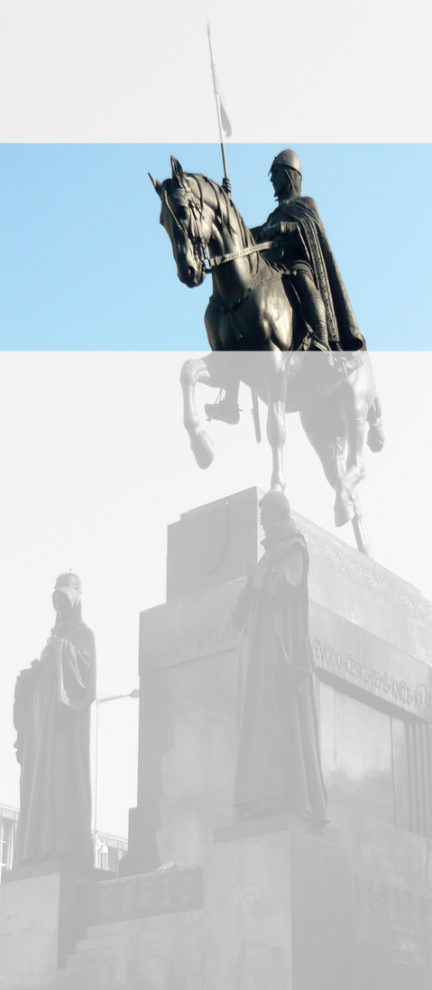
Session VI – National Associations of Employment Lawyers for EELA members

Slide 2
I Specialization
Björn Otto, Arbeitsgemeinschaft Arbeitsrecht, Germany Aldo Bottini, AGI, Italy

Slide 3
Aldo Bottini / Björn Otto
Contents
Formal accreditation as employment law specialist
Accreditation body
Criteria for obtaining accreditation: Training and / or practice
How to maintain accreditation
Discussion points
Pros & Cons

Slide 4
Aldo Bottini / Björn Otto
Formal accreditation as employment law specialist
YES | indirect accreditation (through association) | NO
Germany Italy (awaiting finalization) | The Netherlands | Denmark Spain UK

Slide 5
Aldo Bottini / Björn Otto
Accreditation body
Germany | Regional Bar (Rechtsanwaltskammer)
Italy | National Bar
The Netherlands | Association (Vaan) recognized in turn by the National Bar

Slide 6
Aldo Bottini / Björn Otto
Criteria for obtaining accreditation: training and / or practice
 | TRAINING | AND/OR | PRACTICE
Germany | 120 hours 3 written exams | and | − 3 years of practice during the last 6 years − 100 employment cases within last 3 years prior to application
Italy | 200 hours (over 2 years) final exams (written and oral) | or | 8-year bar membership 15 employment cases each year in the preceding 5 years
The Netherlands | 50 hours | and | 5 years as a lawyer 50 % working hours in employment law

Slide 7
Aldo Bottini / Björn Otto
How to maintain accreditation
 | TRAINING | AND/OR | PRACTICE / OTHER
Germany | 15 hours per year | or | scientific article(s) in law journals
Italy | 25 crediti formativi per year | or | 15 employment cases per year
The Netherlands | 16 hours per year

Slide 8
Aldo Bottini / Björn Otto
Do employment law specialist really need formal accreditation?
Which kind of accreditation model (ITA / GER or Dutch)?
Courses versus practice?

Slide 9
PROS & CONS
Aldo Bottini / Björn Otto

Slide 10
II Activities National Associations (NA)
Bronwyn McKenna, UNISON, ELA - UK Charlotte E. Dingemans, DVdK, VAAN - Netherlands

Slide 11
Country | National Association (NA) | No. of Members | No. of Lawyers
Denmark | AnsalaettelsesAdvokater | 500 | 6,0000
Germany | Deutscher Anwaltverein (DAV) - Arbeitsgemeinschaft Arbeitsrecht | 3,860 | 165,000, of which 10,010 hold the title of specialized lawyer for employment law
Italy | AGI | 1,600 | 230,000
Netherlands | VAAN | 1,000 | 17,500
Spain | Asnala | 431 | 150,000
UK | ELA | 6,000 | 129,922 solicitors and 33,586 barristers

Slide 12
Session IV – National Associations of Employment Lawyers for EELA members
TRAINING AND PUBLICATIONS
CONTRIBUTION TO LAWMAKING PROCESS
REPRESENTATION OF MEMBERS' VIEWS
ADR
DIFFERENT CHANGES IN EMPLOYMENT LAW MARKET AND PRACTICE

Slide 13
Session IV – National Associations of Employment Lawyers for EELA members
TRAINING AND PUBLICATIONS
All NA organize at least annual conferences and seminars/trainings with, in Denmark and NL up to 40-50 % members attendance
All NA produce publications
VAAN (NL) produces a weekly newsletter with all relevant case law, twitter feeds and for example newsflashes directly after important press conferences of the Government regarding employment law
ELA (UK) organizes introductory courses employment law

Slide 14
Session IV – National Associations of Employment Lawyers for EELA members
CONTRIBUTION TO LAW MAKING PROCESS
Most NA contribute in formal or informal process to draft legislation, for example by formal Government consultations or in pre-legislative stage
AGI (Italy) suggested a change in procedural rules
ELA (UK) commented proposals to extend trading in retail shops on Sunday
VAAN (NL) is initiating empirical research on changes in employment law in 2015

Slide 15
Session IV – National Associations of Employment Lawyers for EELA members
REPRESENTATION OF MEMBERS' VIEWS
All NA represent diverse views of lawyers acting for employers, employees or labour unions
AGI (Italy) balances the management positions (lawyers assisting employers and employees)
Observing political and confessional neutrality is a strength

Slide 16
Session IV – National Associations of Employment Lawyers for EELA members
ADR
ADR growing in importance in most jurisdictions
NL: specific employment law mediators association (VAM)
Germany: working group within DAV dealing with ADR (although in employment law ADR no big role)
UK: ELA set up sub committee Arbitration and ADR (increased use of arbitration, especially in high value employment law claims)
Italy: AGI set up ADR committee (settling disputes)

Slide 17
Session IV – National Associations of Employment Lawyers for EELA members
DIFFERENT CHALLENGES IN EMPLOYMENT LAW MARKET AND PRACTICE
All NA face their own challenges concerning changes to substantive law, procedures and the market for employment law services
UK: pro bono work is an important feature of NA
Denmark: competition with accountants
Germany: significant increase number of lawyers
Spain: uncertainty due to labor reform and formation of new government
Italy: no uniformity Italian courts
NL: uncertainty outcome legal proceedings due to new law

Slide 18
III Cooperation between EELA
and National Associations
Benefits to be obtained?
Ana Gomez, ASNALA, Spain Jacob Sand, AnsættelsesAdvokater, Denmark

Slide 19
Session IV – National Associations of Employment Lawyers for EELA members
RESOURCE SHARING
KNOWLEDGE ACQUISITION
GROWTH AND DEVELOPMENT
VISIBILITY AND SOCIALIZATION

Slide 20
Session IV – National Associations of Employment Lawyers for EELA members
RESOURCE SHARING
Gathering Employment Lawyers Associations of Europe to implement common initiatives respecting their autonomy and independence.
Establishing a permanent link between the Employment Lawyers Associations of Europe, mainly by organizing regular meetings.
Sharing problems and experiences with other European associations may contribute to improving local legislation.
Useful exchange of information such as good practices, tariffs, and developing the profession in each country.

Slide 21
Session IV – National Associations of Employment Lawyers for EELA members
KNOWLEDGE ACQUISITION
Promoting development, knowledge and continued training of labour law at European level.
Seminars, courses and lectures to train and help associations to upskill on specific issues.
Creating a database of top qualified speakers in the field of international and EU labour law.
Designating a representative from each European association to coordinate with EELA and the rest of the National Associations.

Slide 22
Session IV – National Associations of Employment Lawyers for EELA members
GROWTH AND DEVELOPMENT
Expanding the view and seeing how other associations work is a great source for development through the exchange of experiences and points of view.
EELA may collect information of relevant speakers and topics for seminars and make relevant information at EU level accessible to national associations.
Cooperation between EELA and national associations can be helpful to reduce the entry barrier for approaching foreign lawyers and acquiring basic knowledge of employment law in other European countries.

Slide 23
Session IV – National Associations of Employment Lawyers for EELA members.
VISIBILITY AND SOCIALIZATION
Strengthening bonds between national labour associations.
Representing the community of employment lawyers in lobbying before the European institutions.
Promoting harmonization of labour and employment law in Europe.

Slide 24
Session IV – National Associations of Employment Lawyers for EELA members
Thank you for your attention

